Slide 1
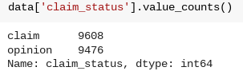
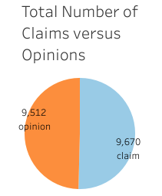
Executive Summary
Milestone 2 of the TikTok Claims Classification Project
UNDERSTANDING THE DATA
The TikTok data team aims to create a machine learning model to classify user submissions as claims. To start, the team must organize the raw dataset and prepare it for subsequent exploratory data analysis.
After reviewing the provided dataset, the variable claim_status seemed particularly useful, given the client’s proposed project. The following screenshots show important points of analysis required to understand the claim_status variable.
The data team conducted a preliminary investigation of the claims classification dataset to identify key relationships between variables.
For the classification task, the team analyzed the counts of claims and opinions to understand the distribution of each type of video content.
Note: The counts of each claim status are quite balanced. There are 9,608 claims and 9,476 opinions.
ENGAGEMENT TRENDS
The data team considered viewer engagement with each video in the claim and opinion categories. In order to understand viewer engagement, the data team considered the view count. The mean and median view count show the impact of each category of video; specifically, the mean and median view counts for both categories show the association between content (claim or opinion) and the video views.
Claims:
Mean view count claims: 501029.4527477102
Median view count claims: 501555.0
Opinions:
Mean view count opinions: 4956.43224989447
Median view count opinions: 4953.0
The preliminary analysis will influence the subsequent steps significantly. To assess the impact of user videos, the data team identified two key variables: video_duration (in seconds) and video_view_count. Both variables are crucial for developing future prediction models.
Pie chart visualizes the comparison of the count of claims and opinions
There is a near equal balance of opinions versus claims. With this understanding, we can proceed with our future analysis knowing that there is a fairly balanced amount of claims and opinions for the videos included within this dataset.
With the key variables identified and the initial investigation of the claims classification dataset, the process of exploratory data analysis can begin.

